Slide 1
Ames housing dataset modelling challenge
Leonardo Blas

Slide 2
Can we predict housing prices?
We have:
A dataset of properties sold from 2006 to 2010 in Ames, IA.
~1500 entries.
~80 parameters.
We want:
A model to predict housing prices.
To minimize the error in terms of dollars (RMSE).

Slide 3
Process overview
Consider the features we want to use.
Clean the data.
Transform the data (encode, standardize, normalize).
Try different models.
Choose the best performing model.

Slide 4
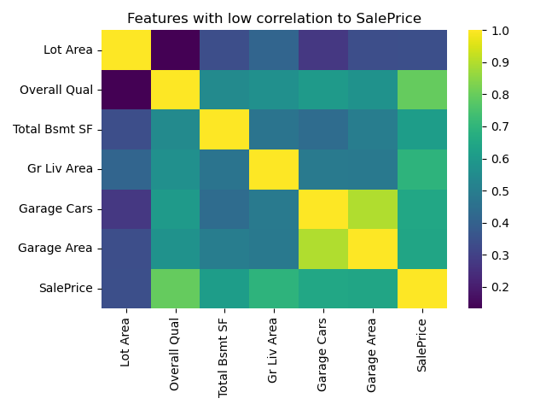
What features to use
Overall quality.
Living area area.
Basement area.
Garage car capacity.
Garage area.

Slide 5
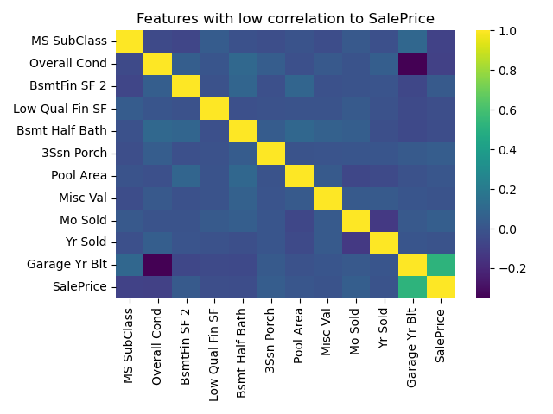
What not to use
Overall condition.
Year sold.
Month sold.
Pool area.
Basement half bathrooms.

Slide 6
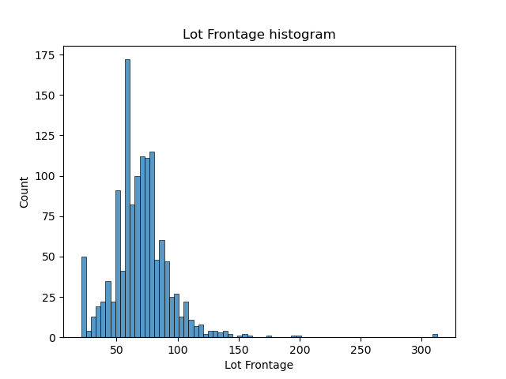
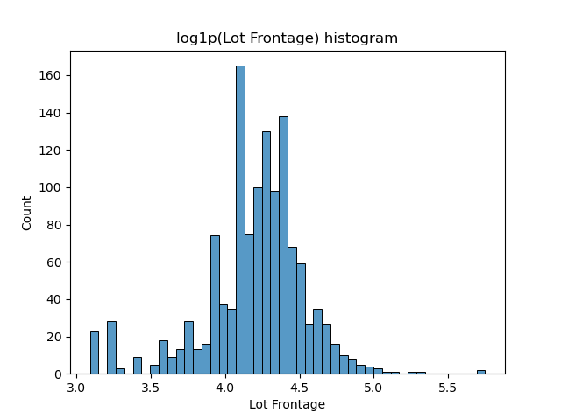
Helpful transformations
log1p.
Power.
KNN imputation.
Standard scaling.

Slide 7
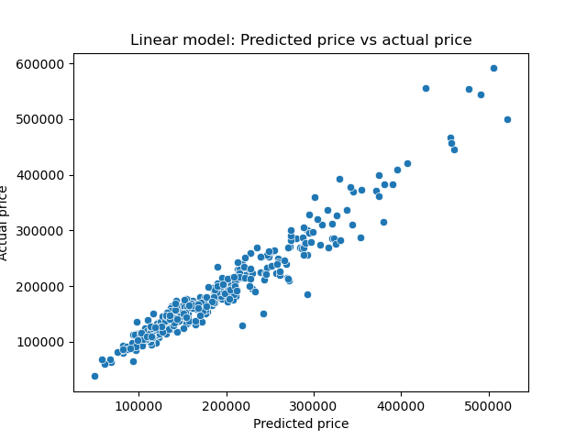
My models: Linear
Train RMSE: ~$17k
Test RMSE: ~$21k
Train r^2: ~0.95
Test r^2: ~0.93

Slide 8
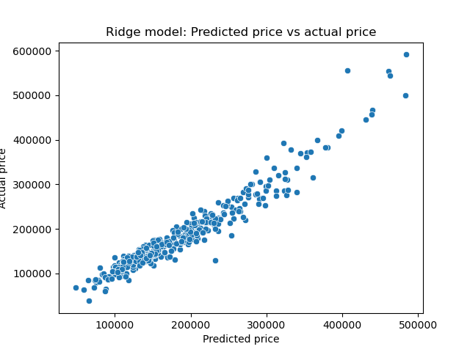
My models: Ridge
Train MSE: ~$21k
Test MSE: ~22k
Train r^2: 0.94
Test r^2: 0.93

Slide 9
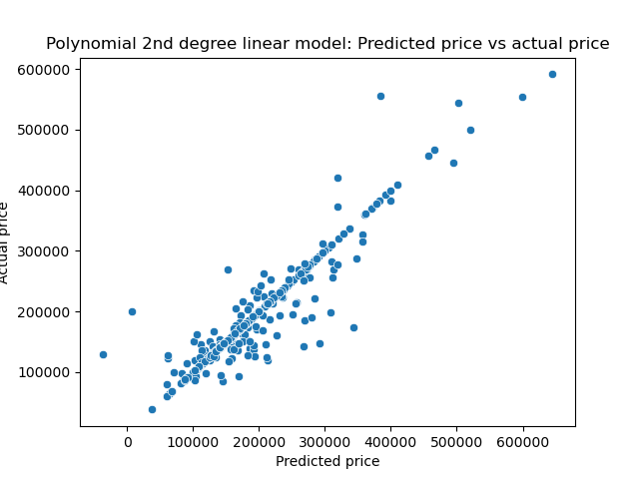
My models: Polynomial linear
Train RMSE: ~$34k
Test RMSE: ~$68k
Train r^2: 1.0
Test r^2: 0.87

Slide 10
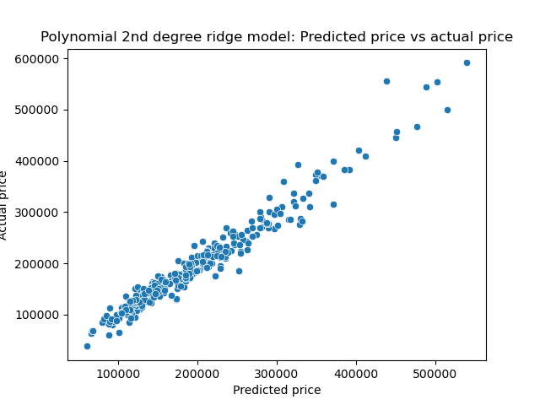
My models: Polynomial ridge
Train RMSE: ~$19k
Test RMSE: ~$17k
Train r^2: ~0.97
Test r^2: ~0.96

Slide 11
Findings and recommendations
Data doesn’t lie: Build models considering the data patterns.
It’s hard to summarize inter-parameter interactions.
Parameters like overall quality and garage area are important.
Some data is almost irrelevant.
A 2nd degree polynomial ridge model is efficient.

Slide 12
References
[1] J. O, M. Harris, "Ames Iowa Submission". 2024. https://kaggle.com/competitions/adobe-dsb-34.

